Slide 1
New Window Project
Thomas Yu

Slide 2
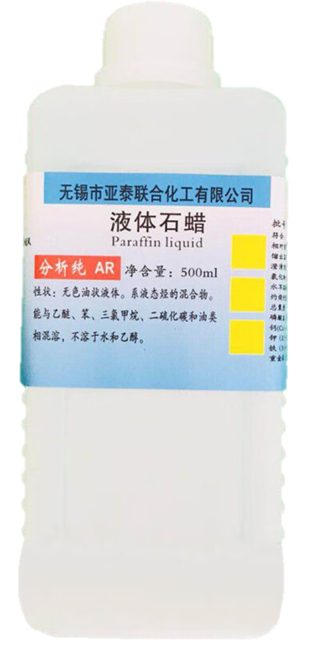
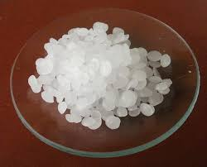
Phase Change Material(PCM)
What is P C M?
A Phase Change Material (PCM) is a substance that absorbs or releases a significant amount of latent heat when it changes its physical state, typically between solid and liquid phases. This change in phase occurs at a specific temperature, making PCMs useful for thermal energy storage and temperature regulation.
The advantages
Parraffin wax is cost-effective.
Its melting point (46℃-68℃)meets our demand.
It is Chemically stable. This means that paraffin wax is not prone to degradation during multiple thermal cycles and is able to maintain its heat storage properties.

Slide 3
More info of PCM
However, I found that the heat conductivity of pure Parraffin wax is low(0.2-0.5W/mk). Heat conductivity determines the rate at which heat is transferred through a material per unit time and per unit area. (Q=k⋅A⋅ΔT​/d)
The higher the thermal conductivity, the stronger the ability of the material to transfer heat. To improve the thermal conductivity of paraffin, high thermal conductivity materials such as metals, graphite(石墨), and carbon materials are added to paraffin to form composite materials.
This allows the composite material to provide higher thermal conductivity through the conductive materials, thereby accelerating the absorption and release of heat. By composite, not only is the thermal conductivity of paraffin improved, but the other advantages of paraffin are also maintained.
After mixing with graphite, the Heat conductivity increased to 1.5–5 W/m·K .
Of course, the cost is the first thing to consider. Graphite:10CNY/500g
With 5%-10% of Graphite and 90%-95% of wax.

Slide 4
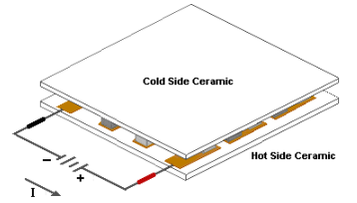
Thermoelectric cooler(TEC)
TEC is indispensable in our project. In summer, the cold side is placed inside so that it absorb the heat in the room and transfer it into PCM, then the load of the AC system can be declined. No more extra energy is required because it is powered by PV cells. In winter, by reversing the direction of the current, the thermoelectric cooler (TEC) can switch the roles of the hot and cold sides. This reversal mechanism enables the TEC system to provide both heating and cooling capabilities, making it a versatile and energy-efficient solution for maintaining indoor comfort year-round.
If the thermoelectric cooler (TEC) is not properly managed in terms of heat dissipation, it can easily overheat and get damaged. The heat dissipation of the hot side is critical to the TEC's performance and longevity. So I think the heat conductivity of PCM is essential. And we must examine whether TEC can still work in extreme cases. I am wondering whether the TEC is always turned on. Or can we install a micro-temperature sensor inside to ensure TEC’s longevity?(This may cost more money)

Slide 5
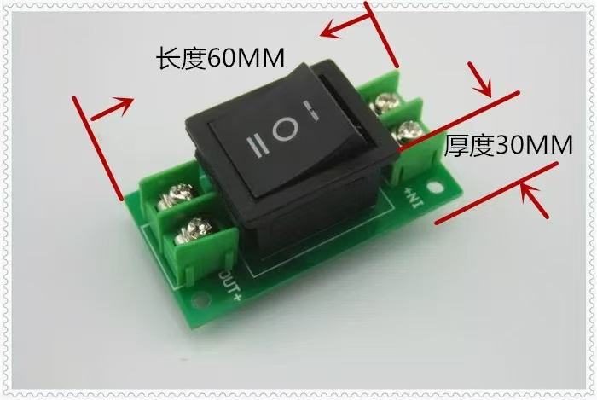
After a simple search on the Internet, I found that installing a temperature sensor and controller may cost around 100 CNY for each window. However, these devices might break down under high temperatures. A common solution to this issue is to limit the power supplied to the TEC, allowing it to operate consistently. The optimal power level for the TEC can be determined through lab testing.
Then, I begin to wonder how can we switch the direction of current? Luckily, There’s a simple way: using polarity-reversing switch. The electricity generated by PV cells is direct current(DC). So, By incorporating a polarity-reversing switch, we can easily reverse the direction of current flowing through the thermoelectric cooler (TEC). This method is cost-effective, easy to implement, and ensures reliable operation in the system.
7 CNY

Slide 6
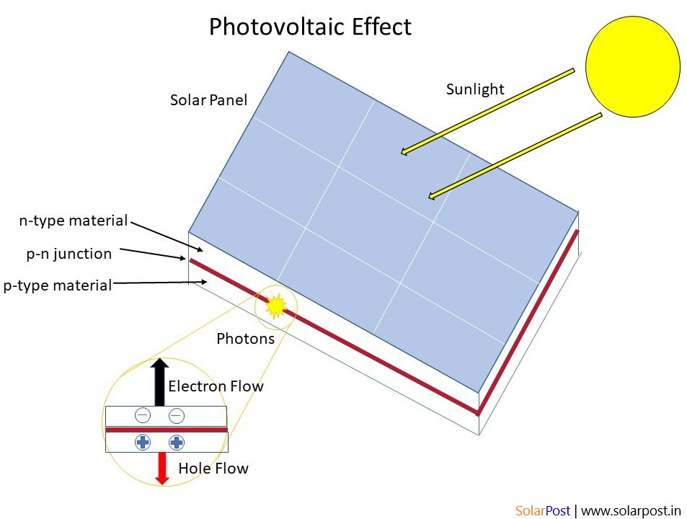
PV Cells
In the proposed sliding window system, PV cells play a crucial role by providing a sustainable and renewable energy source to power the entire system. The photovoltaic cells are installed on the exterior side of the sliding window, where they capture sunlight and convert it into direct current (DC) electricity. This electricity is then used to power TEC .The PV cells make the system more energy-efficient and environmentally friendly. Additionally, the energy harvested from the PV cells can be stored in batteries for later use, ensuring continuous operation even when sunlight is unavailable. The integration of PV cells thus not only contributes to energy savings but also enhances the overall functionality and sustainability of the window system

Slide 7
The voltage generated by photovoltaic (PV) cells is unstable, depending on factors like light intensity and temperature. Generally, the open-circuit voltage (Voc) of a PV cell ranges between 0.4V and 0.7V, which cannot be directly used to power a thermoelectric cooler (TEC). One solution is to store the energy in a battery and then stabilize the output voltage and current to meet the TEC’s requirements. Given the environmental conditions of the window system, the battery should be less sensitive to temperature variations. Lithium batteries perform better than lead-acid batteries in environments with significant temperature fluctuations. Additionally, it is essential to ensure that the battery's rated voltage matches the optimal voltage required by the TEC. A suitable charge controller should also be chosen to automatically adjust the charging process based on the voltage output of the PV cells, preventing overcharging or deep discharging of the battery. This will help extend the battery’s lifespan. Meanwhile, a DC-DC converter and a voltage regulator can be used to convert the unstable, low voltage from the PV cells into a stable and suitable value. It is important to note that low and unstable charging currents can severely affect the lifespan of lithium batteries.
The battery is optional, only using DC-DC converter and voltage regulator is OK!

Slide 8
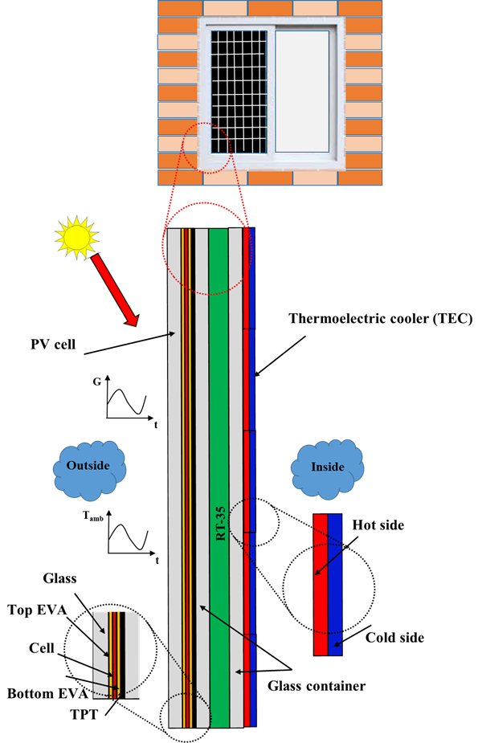
All in all:
The new design of the sliding window integrates a photovoltaic (PV) cell, thermoelectric cooler (TEC), and phase change material (PCM). Its main functions are:
Reducing Air Conditioning Energy Consumption: By combining the thermoelectric cooler with phase change material, the system can assist in lowering indoor temperature during the summer, reducing the load on the air conditioning system and thereby cutting electricity consumption.

Slide 9
Thank You

